Slide 1

DS 210 : Intro to Data Science Final Project
Robert Daniels, Spring 2022

Slide 2
Introduction and Stating the Question
Challenge
Perform exploratory data analysis
Sanitize data inputs, if needed
Attempt to build a linear regression model in KNIME
Test this model for reliability
Goal
Can we predict the outside temperature based on the frequency of cricket chirps?

Slide 3

The Data Set

Slide 4
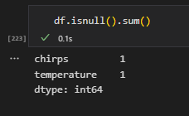
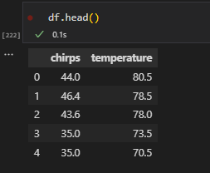
Initial Findings
The raw .csv file contains 58 records of type float, with a shape of (59,2) including the attribute labels
Chirps: cricket chirp frequency (per 15 seconds)
Temperature: Fahrenheit
Each attribute contains 1 record with a null value

Slide 5
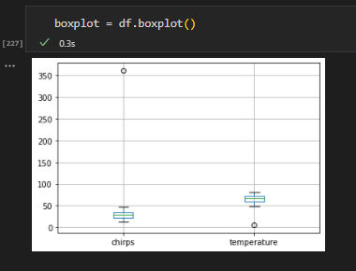
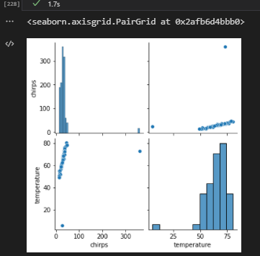
Data Analysis: Outliers
Outliers are visually evident in the data set. That won’t do!

Slide 6
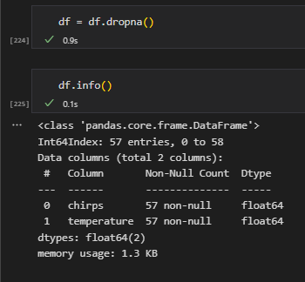
Data Analysis : The messy null
In this case, the null values represent a small portion of the data set.
Thus, we can safely remove the 2 records in question.

Slide 7
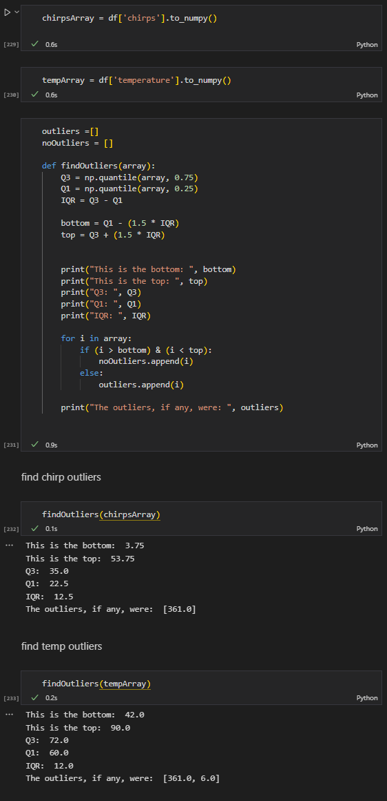
Data Analysis : Outliers
Outliers are clearly skewing the data set
Solution: apply statistical reasoning to find the outliers in question

Slide 8
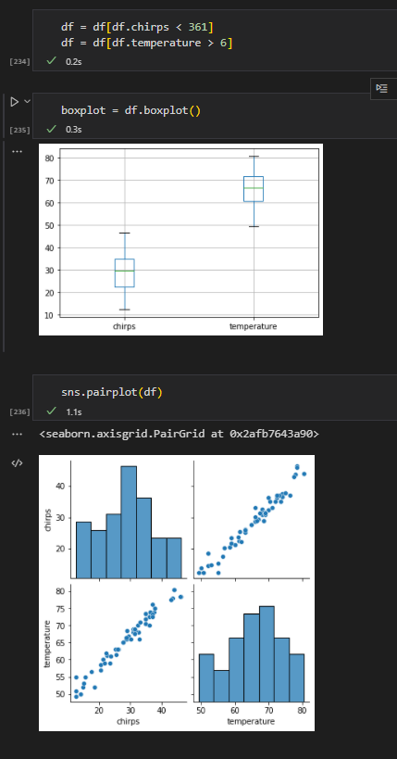
Data Analysis: Outliers
Mask out the outliers from the data set
Much better!
A linear relationship emerges from the data

Slide 9
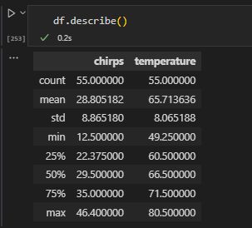
Data Analysis: General Statistics

Slide 10
Refining the question: Any reason to change our goal?
Recall
Our goal was to see if there was a strong correlation between chirp frequency and temperature
Visualize
Visually, a strong linear trend can be seen between these two attributes
Build
Next step: Use KNIME to build a model

Slide 11
Model Building: KNIME
Using the KNIME platform, we can build a linear regression model based on the data set.
Linear Regression is a supervised learning method.
We provide the computer with a subset of known data
Let the computer build a model off said data
Verify the model with another subset of known data

Slide 12
KNIME: Workflow

Slide 13

KNIME: Correlation coefficient and Statistics

Slide 14
KNIME: Regression Line
Y = mx + b
X (slope)
b(y intercept)

Slide 15
KNIME: Prediction
40 chirps 15 seconds, use equation

Slide 16

Interpretation / Summary

Slide 17
Next Steps
Gather
Gather more data and test the model further
Check
Check for confounding factors: humidity, time of day, time of year
Explore
Explore business test cases

Slide 18
Recap:
We formed our initial question
Can we estimate outside temperature based on chirp frequency
Explored our data set
Scrubbed our product for processed
Fed our model the data set in KNIME
Validated our data set
Interpreted and came to a conclusion based off the model results
Determined null values
Determined outliers present
Removed null values
Discarded outliers
Using the regression formula generated by the model
Based off these data, ambient temperature CAN be estimated based off chirp frequency

